Slide 1
NRCan OpenDRR Platform
Technology Brief

Slide 2
Stated objective
“The OpenDRR platform aims to provide tools to investigate, assess, and mitigate natural disasters for policy makers, risk analysts, private and public institutions, and citizens to facilitate decision-making prior to and during crisis.”

Slide 3
Motivation – Policy on Digital
Principles:
design with users
iterate and improve frequently
work in the open by default
use open standards and solutions
collaborate widely
Good news: there are protocols and workflows to facilitate this!

Slide 4



Primary Users & Their Requirements
Risk Analyst
Generate scenario outputs
Allow for peer-review of outputs
Disseminate outputs
Emergency Manager, Land-Use Planner, Risk Manager
Access to up-to-date hazard scenarios
Access to scenario outputs and datasets
Ability to integrate scenario data into a GIS
Public
Intuitive and context aware access to hazard scenarios
High level overview of risk
Natural language descriptions and simple but effective visualizations

Slide 5

Workflow
Refine
Model Scenarios
Generate Scenario Outputs
Peer Review
Publish
Share

Slide 6






Key Components
RiskProfiler
FGP
OpenQuake Engine
GitHub Data Repository
Federal Geospatial Platform (FGP)
Public Portal (RiskProfiler.ca)
GitHub
OpenQuake Engine

Slide 7

Open Quake Engine
OpenQuake Engine
GEM’s state-of-the-art, open-source software collaboratively developed for earthquake hazard and risk modelling
Generates raw scenario outputs for further processing
Risk Analysts push outputs to the GitHub data repository
Scenario Outputs
GitHub

Slide 8




GitHub Data Repository
OpenQuake Engine
Versioned datasets
Pre-release: intended for peer-review and editing (Private Repo)
Final release: intended for broader dissemination (Public Repo)
GitHub pages
Models
Datasets
Documentation
Scenario Outputs
Custom ETL Process
Spatial Database
GitHub

Slide 9







Federal Geospatial Platform
CGP
Open Data
F/P/T Portals
Emergency Theme
Geospatial clearinghouse for the GC
Enterprise grade turn-key services with the Geo-Community Cloud (GCC)
No need to reinvent the wheel – leverage existing infrastructure
Primary path to Open Data Portal
Sustainability is a driver
FGP
CSW
FGP GCC
OGC
Esri REST
WPS (CZS)

Slide 10



Stakeholder Portal
RiskProfiler
OpenQuake Canada
A fork of the GEM OQ GeoViewer
Facilitates peer review
Primary interface for Domain Experts
3 Levels of Publishing
Private – only the data producer can access
Shared – only those with accounts can access (e.g. peer reviewers)
Public - Open to the world through industry standard API’s
Public
3rd Party SDI’s
SENDAI
Spatial Database
GeoPackage

Slide 11
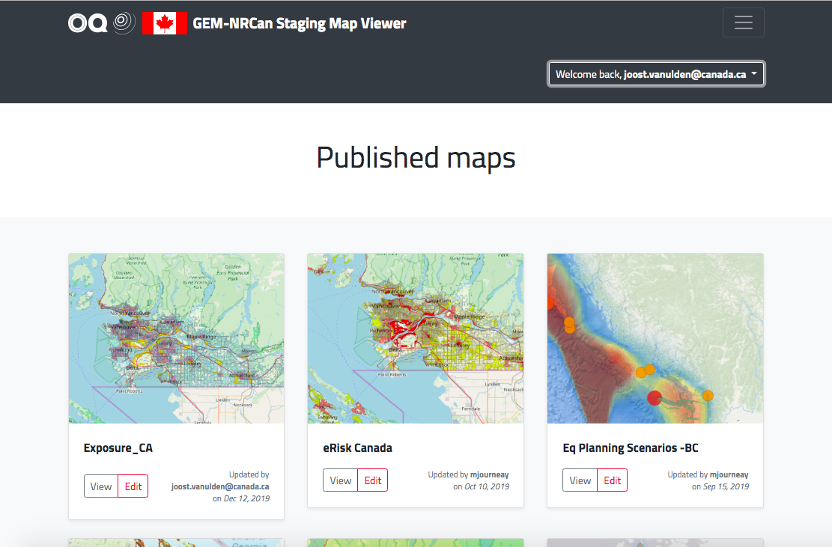
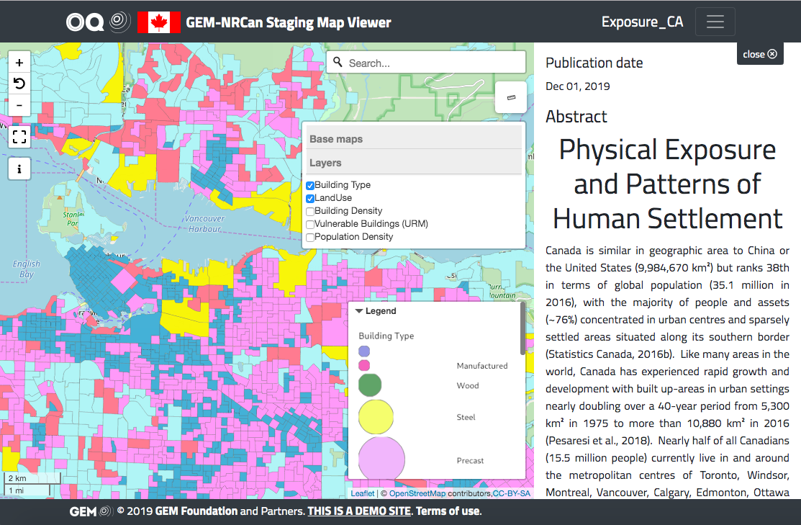
OpenQuake Canada
https://nrcan.openquake.org
Demo site available
Hosted at GEM
Extensible
Standards based

Slide 12
Public Portal
RiskProfiler
https://www.riskprofiler.ca
Purpose-built web application catering to non-experts
Intuitive and context aware
High-level overview of hazard risk
Interactive maps and graphic visualizations with supporting text
Contact points for more information about hazard risk
OpenQuake Canada
Public
3rd Party SDI’s
SENDAI
Spatial Database
GeoPackage

Slide 13
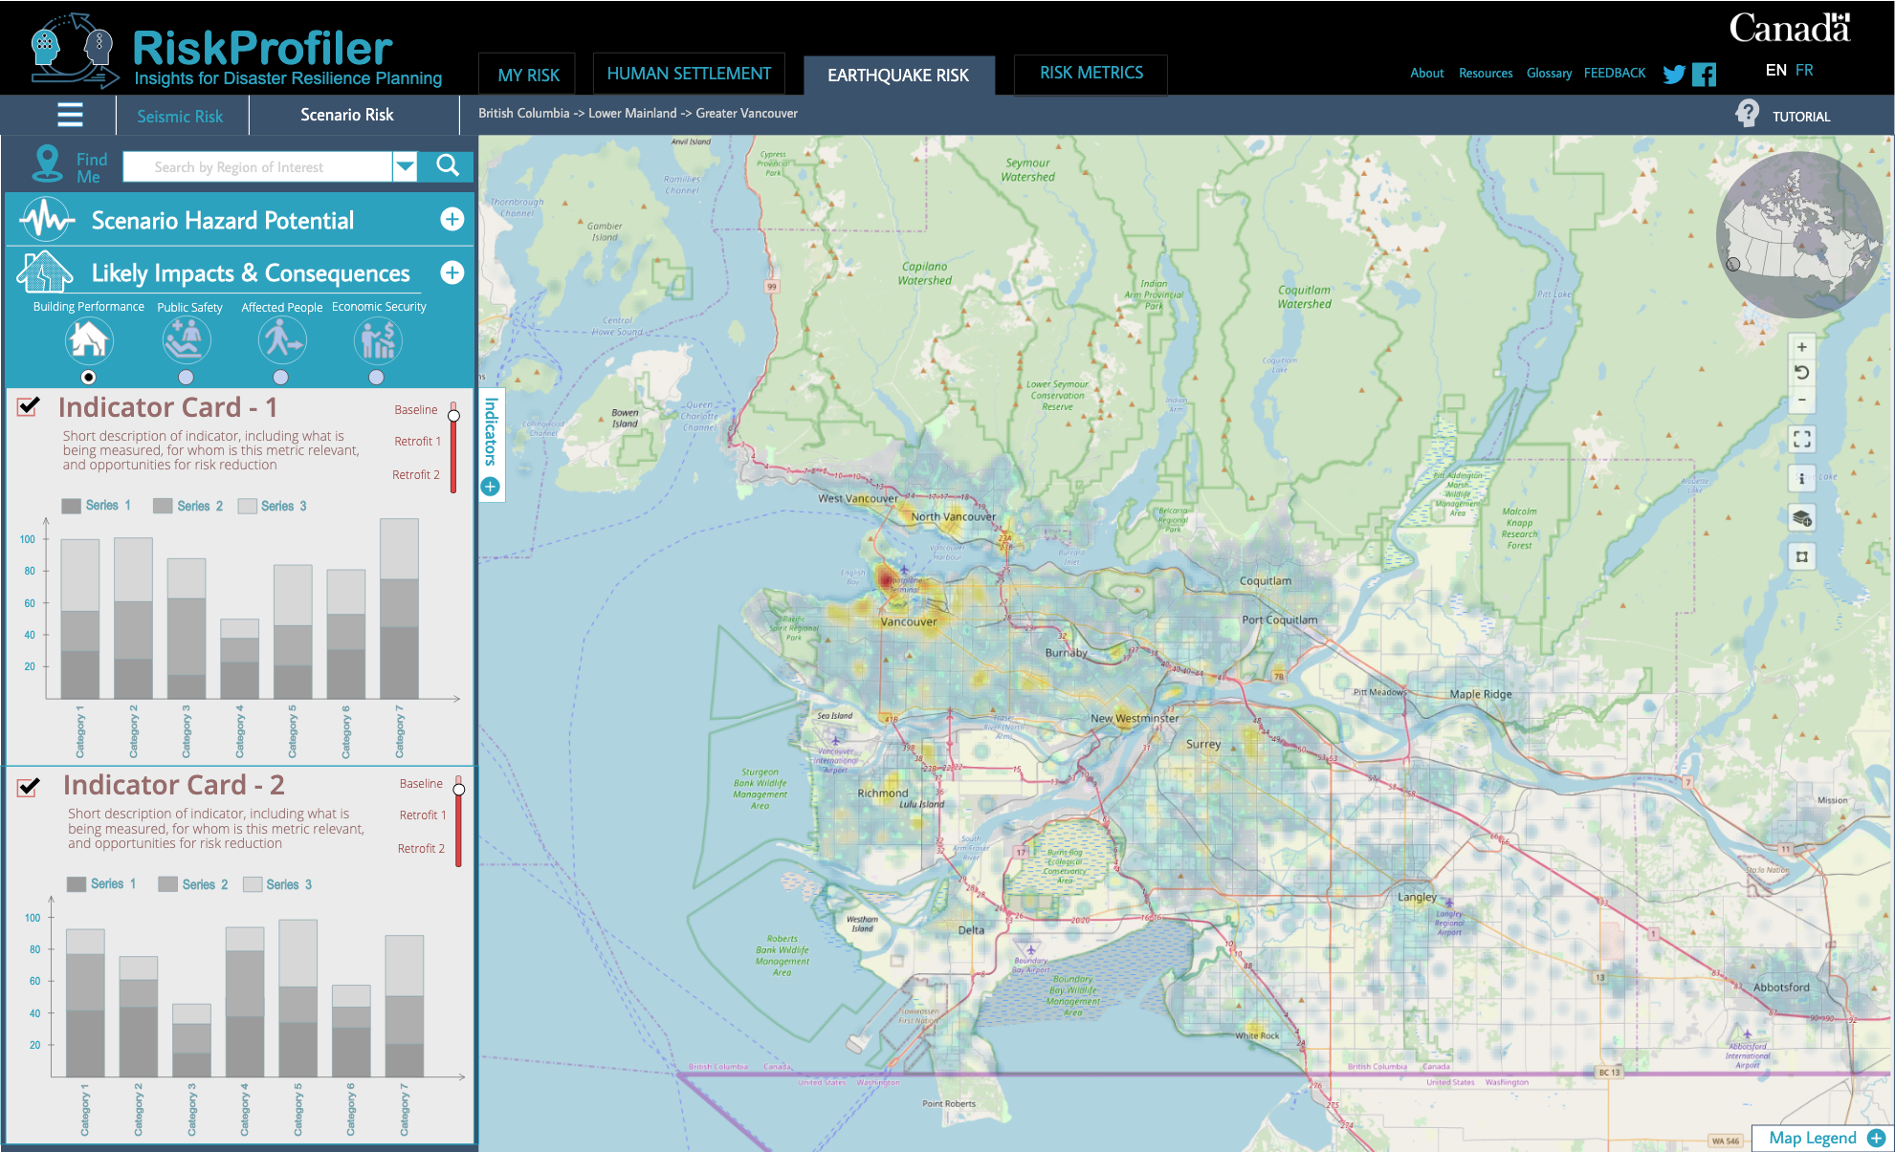
RiskProfiler.ca
Purpose-built web application for non-experts
High-level overview of hazard risk
Interactive maps and graphic visualizations with supporting text
Contact points for more information about hazard risk
OGC API
Elasticsearch
OpenDRR GitHub
Spatial Database

Slide 14
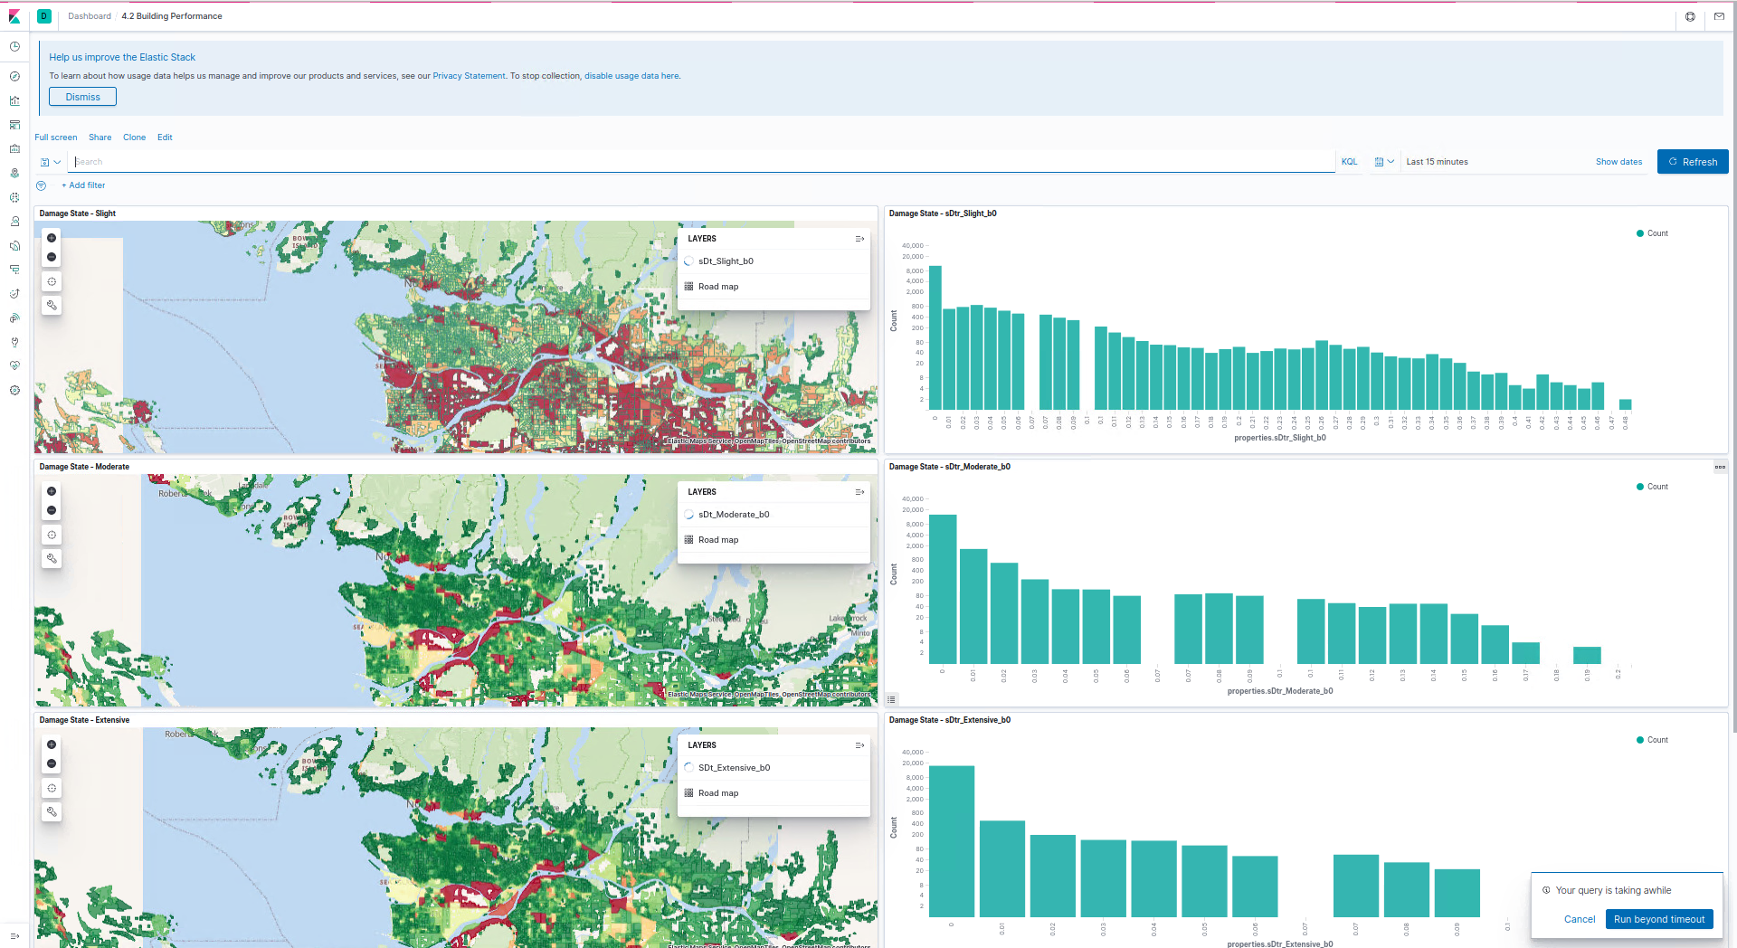
Public Dashboard (Experimental)
Pre-generated dashboards with visualizations will be provided
Allows users to query underlying models and visualize results using charts, graphs, and maps
Users can share results outside of the platform
Kibana
Elasticsearch
OpenDRR GitHub
Spatial Database

Slide 15


OpenDRR Platform
RiskProfiler
CGP
Open Data
F/P/T Portals
Provide tools to facilitate decision making prior to and during a crisis
Emergency Theme
Key Components
OpenQuake Engine
GitHub Data Repository
Federal Geospatial Platform (FGP)
Public Portal (RiskProfiler.ca)
Kibana
OGC API
FGP
CSW
Elasticsearch
Spatial Database
FGP GCC
OGC
Esri REST
WPS (CZS)
Risk Analyst
Emergency Planner, Risk Manager
GitHub pages
GC User
Models
Datasets
Documentation
OpenQuake Engine
OpenDRR GitHub
Public

Slide 16





Summary
RiskProfiler
OpenQuake Engine
OpenQuake Canada
Public
3rd Party SDI’s
SENDAI
Scenario Outputs
Custom ETL Process
Spatial Database
GeoPackage
GitHub

Slide 17
Questions?
Reach me at: joost.vanulden@canada.ca
Find us at:
https://github.com/OpenDRR

